Slide 1
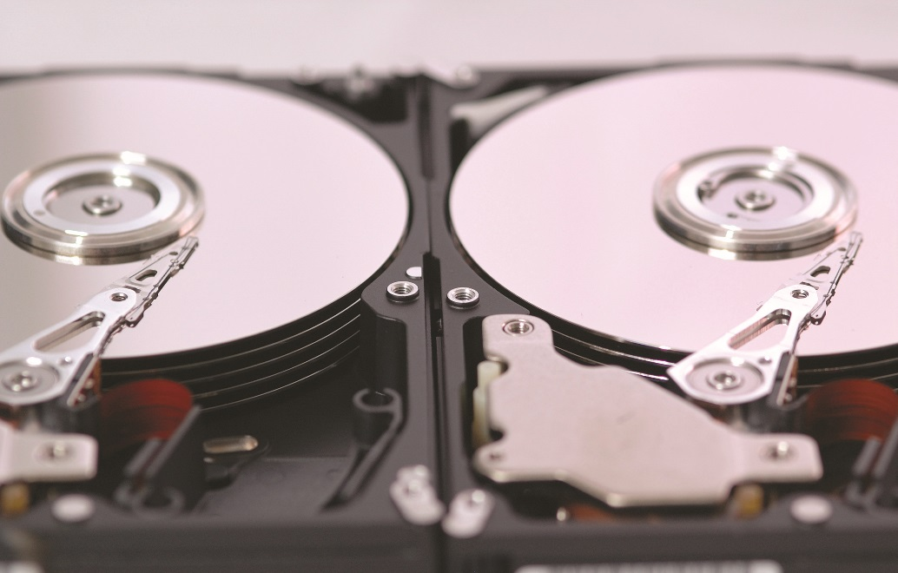
IT Essentials (CompTIA A+) Ch. 9
Hard Drive Technologies
Chapter 9
Notes:
1

Slide 2
Overview
In this chapter, you will learn how to:
Explain how hard drives work
Identify and explain the PATA and SATA hard drive interfaces
Describe how to protect data with RAID
Describe hard drive installation
Notes:
2
Instructor Tip
When gaining attention and establishing common ground, ask questions of the class such as, “Who here has ever installed a hard drive?” or “Who here has ever had a hard drive crash?”
For a positive statement, tell the class, “In this lesson, we are going to learn how to install a hard drive and diagnose hard drive problems.”

Slide 3
How Hard Drives Work
A traditional hard disk drive (HDD) is composed of individual disks or platters.
The platters are comprised of aluminum and coated with a magnetic medium.
Two tiny read/write heads service each platter.
HDDs are referred to as magnetic hard drives or platter-based hard drives
Notes:
3

Slide 4
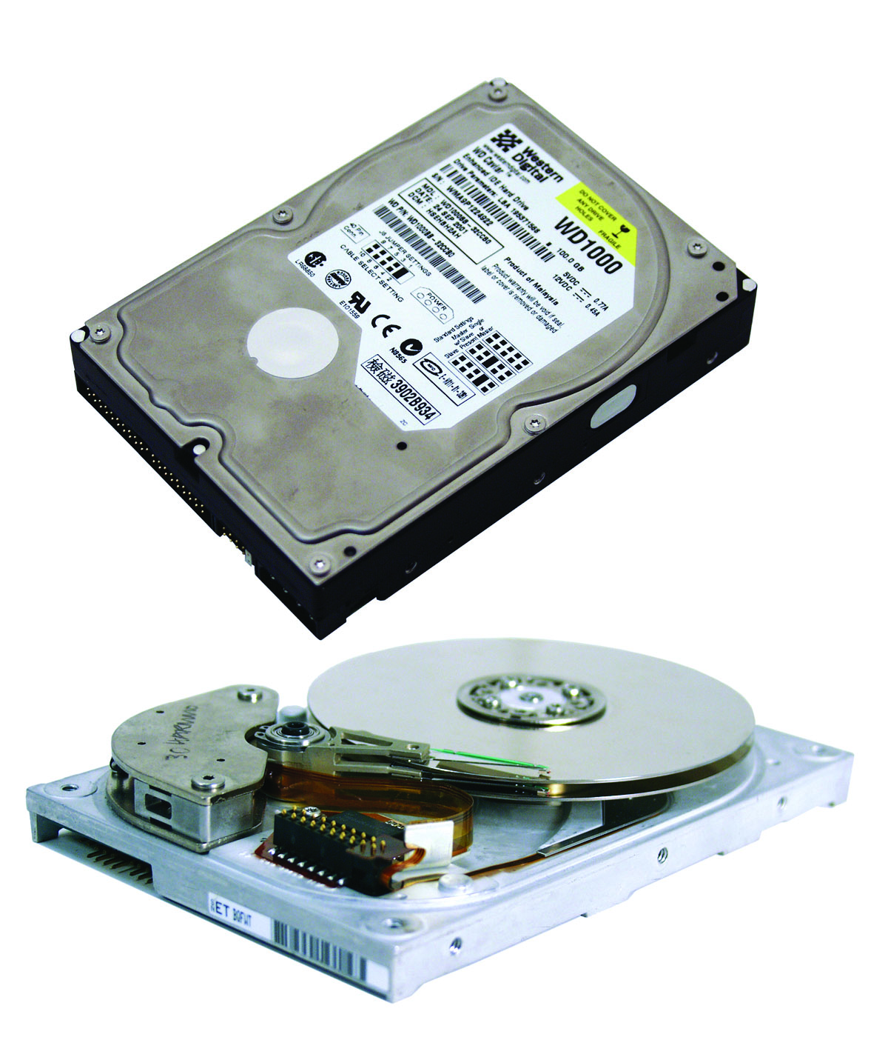
Inside the Hard Drive
Figure 9.1 Inside the magnetic hard drive
Notes:
4
A traditional hard disk drive (HDD) is composed of individual disks, or platters, with read/write heads on actuator arms controlled by a servo motor—all contained in a sealed case that prevents contamination by outside air (see Figure 1).

Slide 5
Spindle (or Rotational) Speed
Hard drives run at a set spindle speed, measured in revolutions per minute (RPM)
Older drives ran at 3600 revolutions per minute (RPM).
Common speeds are 5400, 7200, 10,000, and 15,000 RPM.
Faster speeds means better performance, but also, possible overheating.
Heat can reduce life.
Drive bay fans help airflow.
Notes:
5
Tech Tip
Fluid Bearings
Currently, almost all hard drives use a motor located in the center spindle supporting the drive platters. Tiny ball bearings support the spindle motor. As disk technology has advanced, these ball bearings have become the limiting factor in the three critical design criteria for hard drives: rotational speed, storage capacity, and noise levels. The higher the rotational speed of a drive, the more the metal-on-metal contact creates heat and lubricant problems that impact the lifespan of the bearings. However precisely machined, ball bearings are not perfectly round. The measurement of how much they wobble (and thus how much the drive platters wobble), called runout, is now the limiting factor on how densely you can pack information together on a disk drive. The technological fix? Fluid bearings. A fluid bearing is basically a small amount of lubricant trapped in a carefully machined housing. The use of fluid in place of metal balls means there’s no contact between metal surfaces to generate heat and wear, and no mechanical vibration, so fluid bearings can support higher rotational speeds. The runout of a fluid bearing is about one-tenth that of the best ball bearing, increasing potential information density significantly. The absence of a mechanical connection between moving parts also dramatically reduces noise levels, and the fluid itself acts to dampen the sound further. Finally, liquid bearings provide better shock resistance than ball bearings.

Slide 6
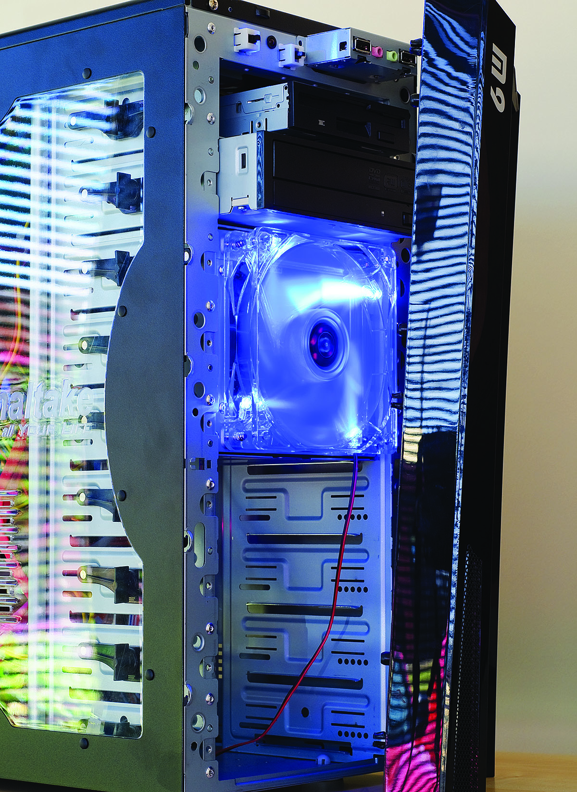
Drive Bay Fan
Figure 9.3 Bay fan
Notes:
6
Drive bay fans sit at the front of a bay and blow air across the drive. They range in price from $10 to $100 (U.S.) and can lower the temperature of your drives dramatically. Some cases come with a bay fan built in (see Figure 3).

Slide 7
Solid-State Drives
A solid-state drives (SSDs) are based on semiconductors and transistors with no moving parts.
Address shortcomings of HDDs
Expensive compared to HDDs
Solid-state technology is commonly used in desktop and laptop hard drives, memory cards, cameras, USB thumb drives, etc.

Slide 8
Solid-State Drives
SSD form factors are typically 1.8-inch, 2.5-inch, or (rarely) 3.5-inch.
Other variations include:
mSATA – standard form used in portable devices
M.2
Add-on PCIe cards
SSDs operate by writing data to high-speed flash memory cells.
Have a finite number of write cycles before wearing out

Slide 9
Hybrid Hard Drives
Windows supports hybrid hard drives.
Combine flash memory and spinning platters
Fast boot times
Add 20–30 more minutes of battery life for portable computers

Slide 10
Parallel and Serial ATA
Advanced Technology Attachment (ATA)
Appeared around 1990, virtually monopolizes hard drive market
ATA hard drives referred to as Integrated Drive Electronics (IDE) drives
Parallel ATA (PATA)
Send data in parallel on a 40- or 80-wire ribbon cable
Serial ATA (SATA)
Send data in serial on one wire
Notes:
10

Slide 11
PATA
Latest ATA/ATAPI-7 standard allows very large hard drives (144 petabytes).
Up to two PATA drives can be connected on a single ATA controller.
ATA-3 introduced Self-Monitoring, Analysis, and Reporting Technology (S.M.A.R.T.).
Internal drive program that tracks errors

Slide 12
SATA
SATA improvements over PATA
Point-to-point connections between the SATA device and the host bus adapter (HBA)
Narrower cables
Maximum cable length 1 meter
Hot-swappable
No drive limit
Theoretically 30 times faster than PATA
1.5Gbps, 3Gbps, and 6Gbps
Notes:
12
Point-to-point means that there are no intermediary chips or devices to slow down the flow of data. The drive and controller follow the same set of rules and it’s only one drive, one controller.
SATA specifications and speeds are: 1.0: 1.5 GBPS; 2.0: 3 GBPS; and 3.0: 6 GBPS.

Slide 13
SATA
SATA Express (SATAe) or SATA 3.2
Ties capable drives directly into the PCI Express bus on motherboards
Lack of overhead enhances speed of throughput
Requires motherboard with SATAe support to take advantage of superfast speeds

Slide 14
AHCI
Current versions of Windows support the Advanced Host Controller Interface (AHCI).
AHCI is an efficient way to work with SATA HBAs.
AHCI supports hot-swapping
If a Windows computer does not have ACHI enabled, must use Add New Hardware Wizard
Native command queuing (NCQ) is a disk-optimization feature that enables faster read/write speeds.
It is best to enable AHCI in CMOS before installing the OS.
Notes:
NCQ is a technology that enables the hard drive to organize read and write requests to optimize them. This is especially useful on server drives that get multiple simultaneous read/write requests.
You must implement AHCI in CMOS before you install Vista/7 (otherwise you must edit the registry).

Slide 15
NVMe
In order for an SSD to work with an OS, the SSD has to include some circuitry that makes it “appear” to be a traditional spinning drive.
Non-Volatile Memory Express (NVMe) specification supports communication connection directly through a PCIe bus lane.
Reduces latency

Slide 16
eSATA and Other External Drives
External SATA (eSATA)
eSATA extends the SATA bus to external devices.
Cable length up to 2 meters are possible.
eSATA extends the SATA bus at full speed.
External drives are encased in the external enclosure.
Notes:
16

Slide 17
Protecting Data with RAID
Data is the most critical part of a PC.
There are several ways to protect data.
Disk mirroring
Reading and writing data at the same time to two drives
Disk duplexing
A separate controller for each drive
Disk striping
Spreading the data among multiple drives
No redundancy
Disk striping with parity
Adds parity data that can be used to rebuild
Notes:
17

Slide 18
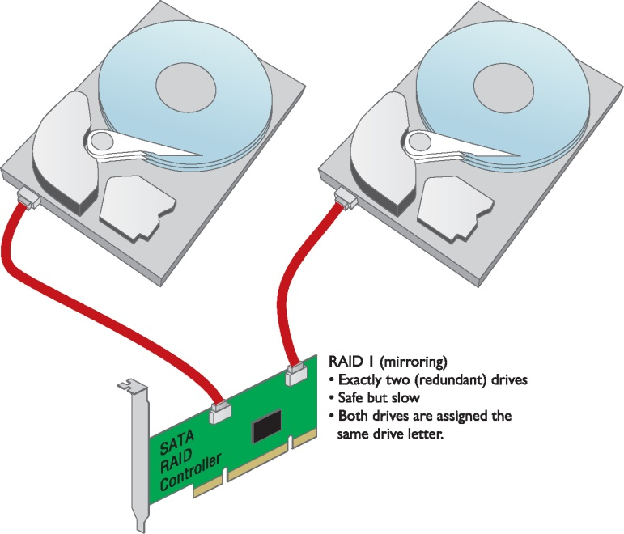
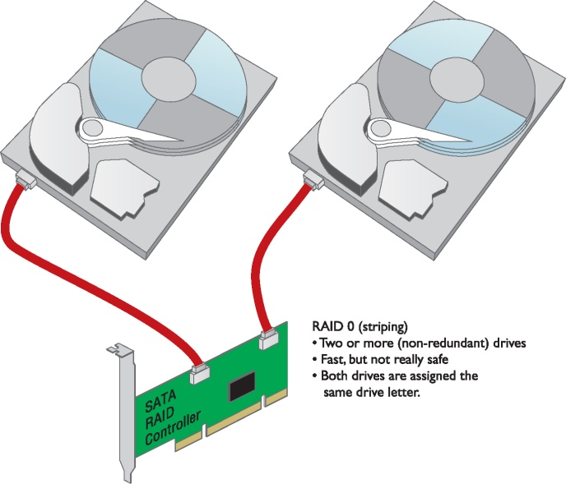
Protecting Data with RAID
Figure 9.12 Mirrored drives
Figure 9.14 Disk striping
Notes:
18
Disk mirroring means that you install a hard drive controller that reads and writes data to two hard drives simultaneously (see Figure 12). The data on each drive would always be identical. One drive would be the primary drive and the other drive, called the mirror drive, would not be used unless the primary drive failed.
You can also use a separate controller for each drive. With two drives, each on a separate controller, the system will continue to operate even if the primary drive’s controller stops working. This super-drive mirroring technique is called disk duplexing (see Figure 13).
Disk striping by itself provides no redundancy. If you save a small Microsoft Word file, for example, the file is split into multiple pieces; half of the pieces go on one drive and half on the other (see Figure 14).

Slide 19
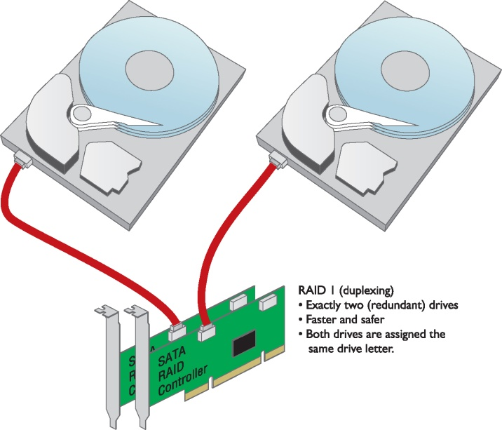
Protecting Data with RAID
Figure 9.13 Duplexing drives

Slide 20
RAID
Redundant Array of Independent (or Inexpensive) Disks (RAID)
RAID 0—disk striping
Requires at least two drives
No redundancy
RAID 1—disk mirroring/duplexing
At least 2 hard drives
Requires double storage space
Notes:
20

Slide 21
RAID
RAID 5—disk striping with distributed parity
Distributes data and parity information across all drives
Fastest way to provide redundancy
RAID 6—disk striping with extra parity
RAID 5 with extra parity information
Larger arrays of disks

Slide 22
RAID
RAID 10—nested, striped mirrors
“Stripe of mirrors”
1 pair of mirrored disks, and another pair mirrors the first pair
RAID 0+1—nested, mirrored stripes
Start with two RAID 0 striped arrays, then mirror the two arrays to each other

Slide 23
Implementing RAID
Thousands of methods can be used to set up RAID.
Specialized RAID controller cards support arrays of up to 15 drives.
Notes:
23

Slide 24
Software Versus Hardware
Software RAID
Operating system is in charge of all RAID functions.
Built-in software RAID comes with Windows.
Hardware RAID
Requires an intelligent controller that handles all of the work of implementing RAID
Invisible to the operating system
Provides needed speed along with redundancy
Provides hot-swapping
Replace a bad drive without disturbing the OS
Notes:
24

Slide 25
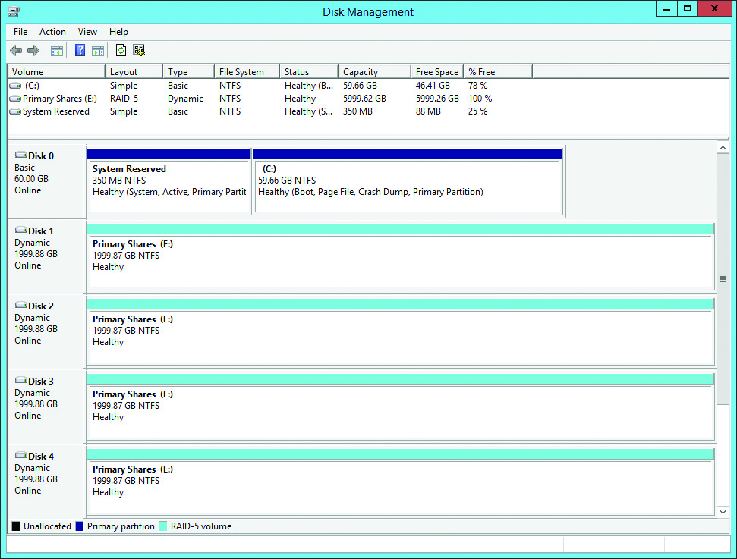
Software RAID Management
Figure 9.15 Disk Management tool of Computer Management in Windows Server
Notes:
25
The most common software implementation of RAID is the built-in RAID software that comes with Windows 2008 Server and Windows Server 2008 R2. The Disk Management program in these Windows Server versions can configure drives for RAID 0, 1, or 5, and it works with PATA, SATA, and/or SCSI (see Figure 15). Disk Management in Windows XP and Windows Vista can only do RAID 0, while Windows 7’s Disk Management can do RAID 0 and 1.

Slide 26
Installing Drives
Choosing your drive
Decide where you are going to put the drive.
Make sure you have room for the drive in the case.
Jumpers and cabling on PATA drives
Master
Slave
Cable select
Notes:
26

Slide 27
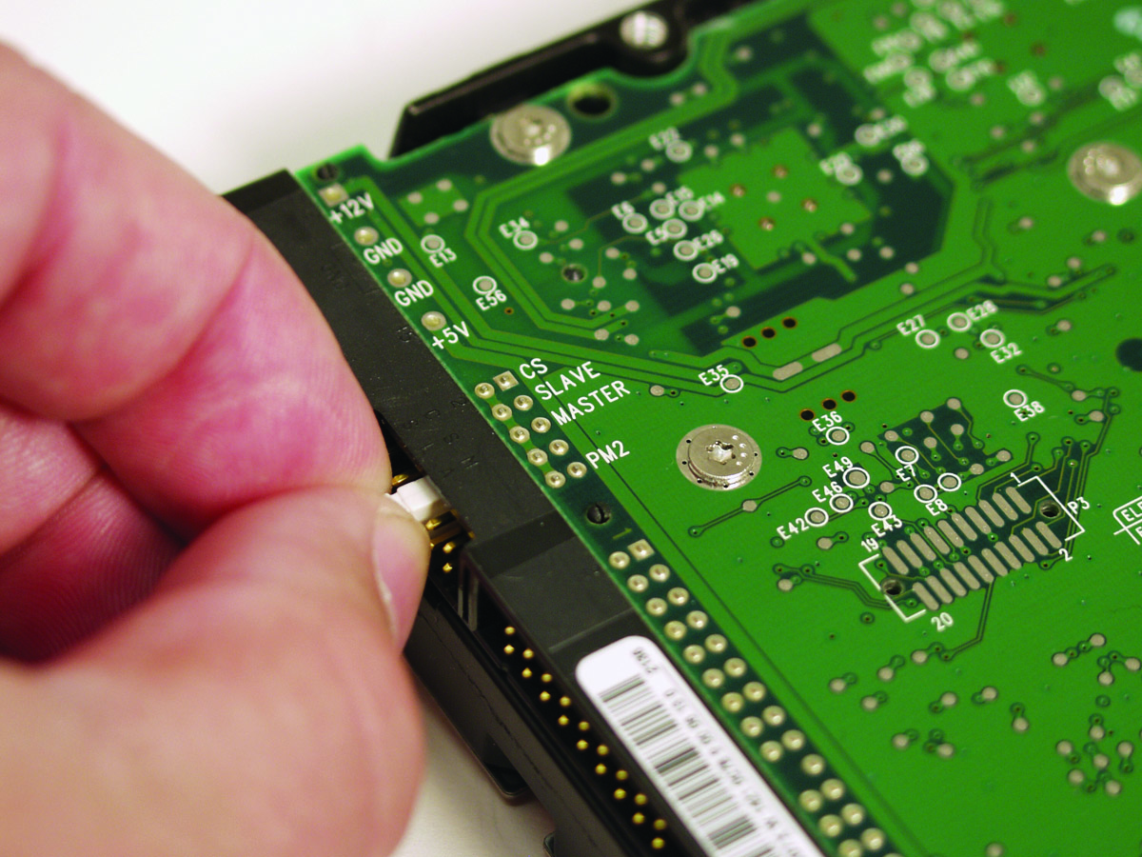
Jumpers
Figure 9.19 Master/slave jumpers on a hard drive
Notes:
27
If you have only one hard drive, set the drive’s jumpers to master or standalone. If you have two drives, set one to master and the other to slave. See Figure 19 for a close-up of a PATA hard drive, showing the jumpers.

Slide 28
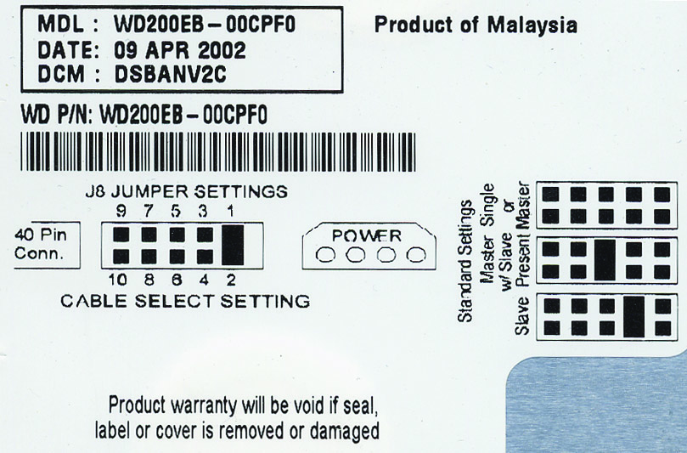
Master/Slave Settings
Figure 9.20 Drive label showing master/slave settings
Notes:
28
Figure 20 shows the label of one of these drives, so you can see how to set the drive to master or slave.

Slide 29
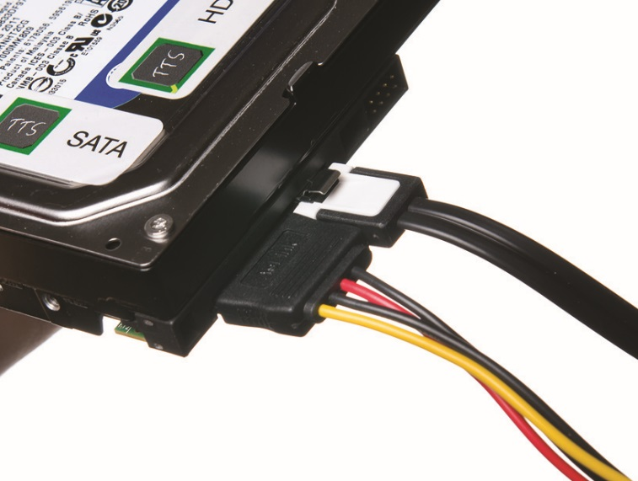
Cabling SATA Drives
Connect the power and plug in the controller cable.
No jumpers
Figure 9.21 Properly connected SATA cable
Notes:
Installing SATA hard disk drives is even easier than installing PATA devices because there’s no master, slave, or cable select configuration to mess with. In fact, there are no jumper settings to worry about at all, as SATA supports only a single device per controller channel. Simply connect the power and plug in the controller cable as shown in Figure 21—the OS automatically detects the drive and it’s ready to go.

Slide 30
Solid-State Drives
Connect the same way as any PATA or SATA drive.
Before replacing an HDD with an SSD, these are considerations:
Do you have appropriate drivers and firmware?
Is everything important backed up?

Slide 31
Configuring CMOS
Configuring controllers
Make sure controllers are enabled.
Autodetection
If controllers are enabled and the drive is properly connected, the drive should appear in CMOS.
SATA uses channels for each controller with channel 1 as the first boot device.

Slide 32
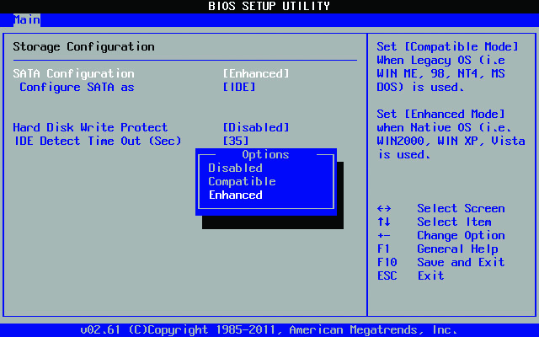
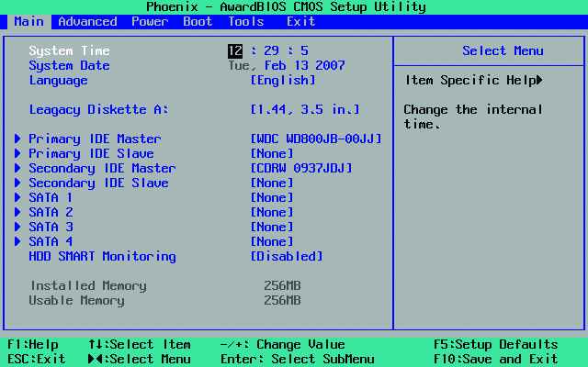
Configuring CMOS
Figure 9.23 Typical controller settings in CMOS
Figure 9.24 Old standard CMOS settings
Notes:
32

Slide 33
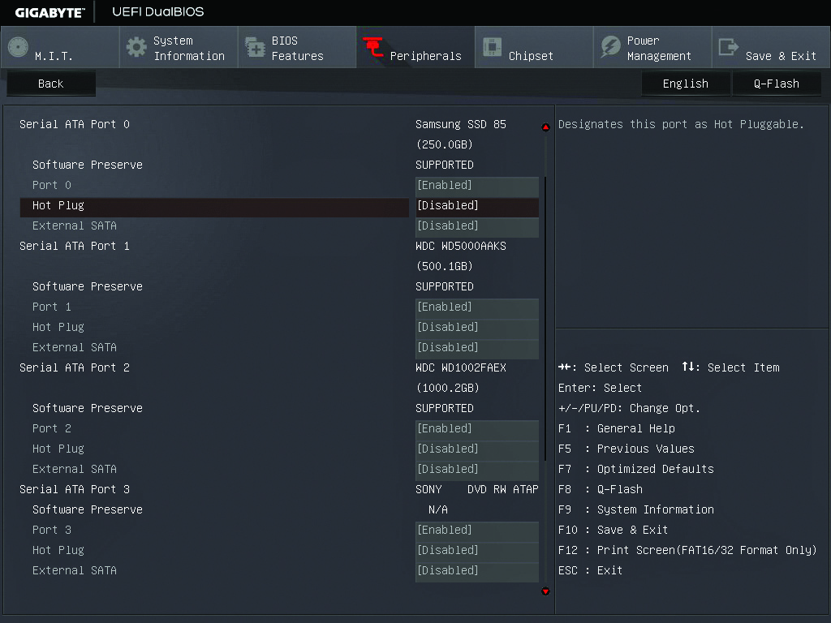
Configuring CMOS
Figure 9.25 Current standard CMOS features
Notes:
33
One common numbering method uses the term channels for each controller. The first boot device is channel 1, the second is channel 2, and so on. (PATA channels may have a master and a slave, but a SATA channel has only a master, because SATA controllers support only one drive.) So instead of names of drives, you see numbers. Take a look at Figure 46.

Slide 34
Configuring CMOS
Boot order
Identifies drive or device from which the system will try to load an operating system
Multiple devices configured
Enabling AHCI
Applies to motherboards that support AHCI
Implement in CMOS
Notes:
34

Slide 35
Now You Try It
Reboot your laptop, and press the correct key to enter the BIOS setup utility.
What option in the CMOS settings lets you configure the boot order?
What other devices are available?
How do you change the hierarchy?
What about removable/USB devices?

Slide 36
Troubleshooting Hard Drives
Drive recognition by a PC requires:
Power
Proper connection
CMOS setup recognition

Slide 37
Troubleshooting Hard Drives
If device is not recognized, work though steps to figure out what went wrong.
Make sure the BIOS recognizes your hard drive.
Use the CMOS setup program to check.
Check physical connections.
Run through issues in CMOS.
Is the controller enabled?
Can your motherboard support the type of drive you are using?

Slide 38
Troubleshooting Hard Drives
If device is not supported by the motherboard:
Flash the BIOS with an upgraded BIOS.
Get a hard drive controller that goes into an expansion slot.

Slide 39
Questions?

Slide 40
Summary
Explain how hard drives work
Identify and explain the PATA and SATA hard drive interfaces
Describe how to protect data with RAID
Describe hard drive installation

Slide 41


